Slide 1


MATH 242
Analytic Geometry and Calculus B
Section 12
Instructor: Jacob Wyngaard
Shell Method

Slide 2


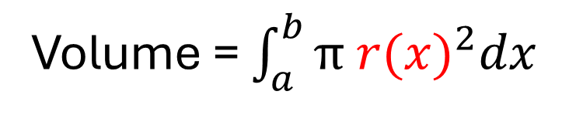
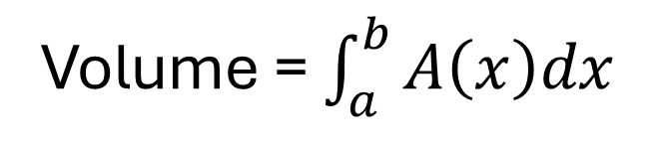




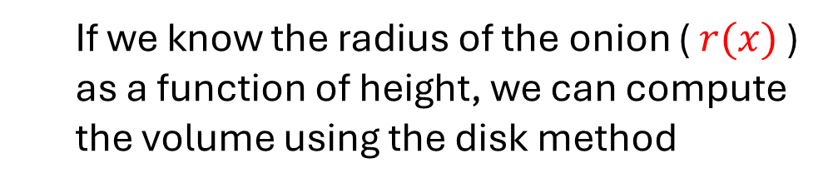

Background
  Suppose we want to find the volume of an onion
$$y$$
  If we know the radius of the onion ( $r(x)$ ) as a function of height, we can compute the volume using the disk method
$$r(x)$$
$$x$$
Volume = $\int_{a}^{b}{A\left(x\right)dx}$
$$x=a$$
$$x=b$$
$$A\left(x\right)=π {r(x)}^{2}$$
Volume = $\int_{a}^{b}{π {r(x)}^{2}dx}$

Slide 3
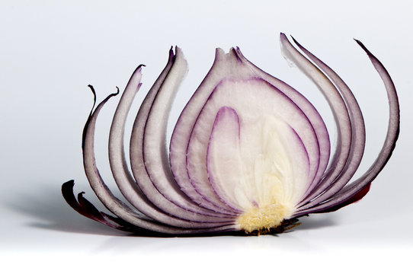
There’s More Than One Way to Slice an Onion
  But there’s another way we can “count volume”
  We can peel the onion!

Slide 4

There’s More Than One Way to Slice an Onion
  What does this look like mathematically?
$$y$$
  - We divide the rotated region into layers
  - Each layer has the same radius
  - Each layer is parallel to the axis of rotation
$$y=c$$
$$x$$
$$x=a$$
$$x=b$$

Slide 5










Disk/Washer Method vs Shell Method
  Disk/Washer Method
  Shell Method
$$y$$
$$y$$
$$y=c$$
$$y=c$$
$$x$$
$$x$$
$$x=a$$
$$x=b$$
$$x=a$$
$$x=b$$
  Slice perpendicular to axis of rotation
  Slice parallel to axis of rotation
  - Generate cross-sections
  - Generate layers

Slide 6
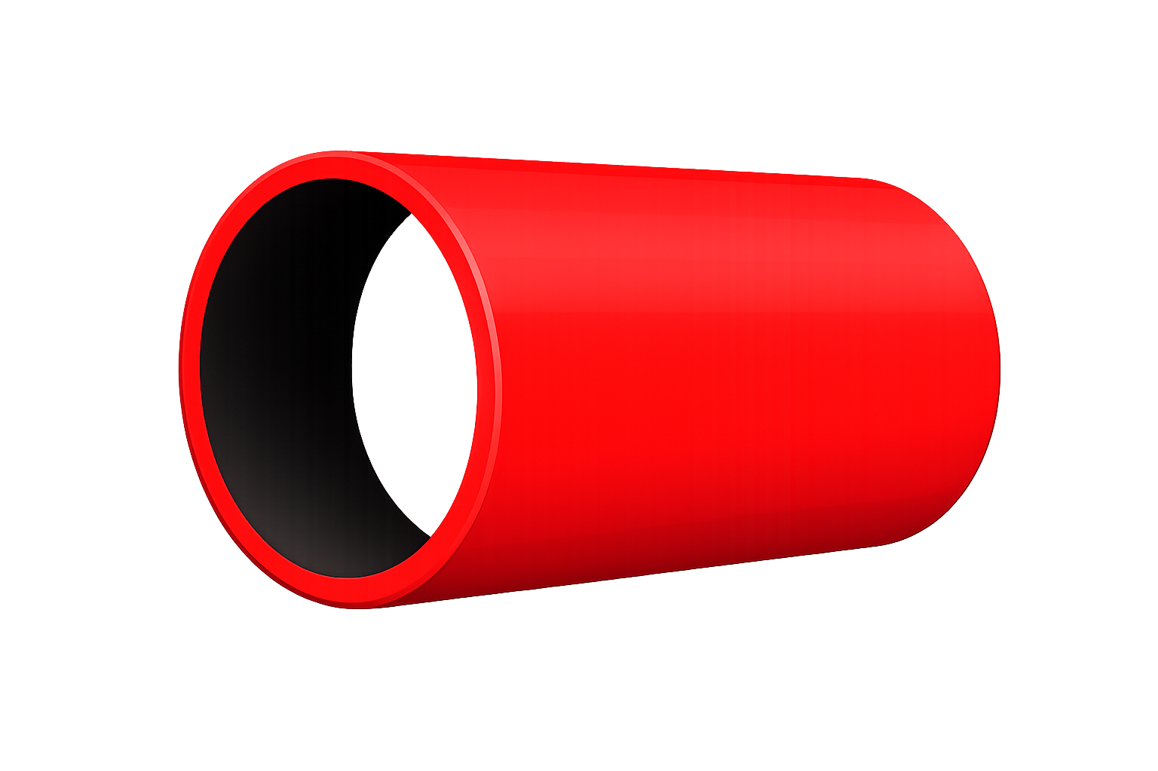








The Shell Method
  We compute the area by rotating each layer, computing the volume of rotated layer and summing the volumes across all layers
What is the volume of the rotated layer?
$$l$$
$$y$$
$$w$$
$$r$$
When this layer rotated, we get:
$$y=c$$
$$x$$
$$x=a$$
This is a pipe of length $l$, radius $r$, and thickness $w$
$$x=b$$
The volume of this pipe = Surface Area $∗w$
In this example, the axis of rotation is the x-axis

Slide 7




The Shell Method
  We compute the area by rotating each layer, computing the volume of rotated layer and summing the volumes across all layers
What is the volume of the rotated layer?
$$y$$
After layer is rotated
$$r$$
The volume of this pipe = Surface Area $∗w$
$$y=c$$
If we flatten this the surface of the pipe, we get the following rectangle:
$$x$$
$l$
$$x=a$$
$$x=b$$
$2πr$
In this example, the axis of rotation is the x-axis
Surface Area = $2πr∗l$

Slide 8


The Shell Method
  We compute the area by rotating each layer, computing the volume of rotated layer and summing the volumes across all layers
What is the volume of the rotated layer?
$$y$$
After layer is rotated
$$r$$
$$y=c$$
The volume of this pipe = $2πr∗l∗w$
$$x$$
$$x=a$$
$$x=b$$
$l$
$2πr$
In this example, the axis of rotation is the x-axis

Slide 9
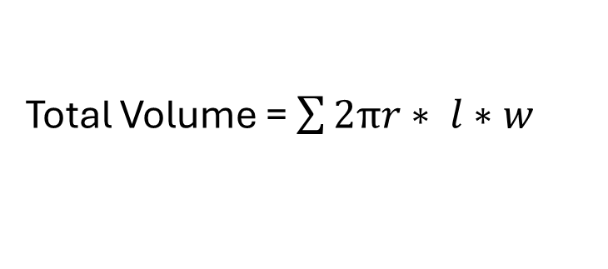



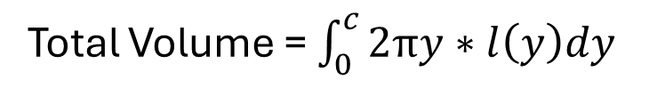
The Shell Method
  We compute the area by rotating each layer, computing the volume of rotated layer and summing the volumes across all layers
$$l$$
When rotated
$$w$$
$$y$$
What is the volume of the rotated layer?
$$y=c$$
Volume = Surface Area * Width
$$x$$
Volume = $2πr∗ l∗w$
$$x=a$$
$$x=b$$
Total Volume = $\sum{2πr∗ l∗w}$
Total Volume = $\int_{0}^{c}{2πy∗l\left(y\right)dy}$
In this example, the axis of rotation is the x-axis

